Slide 1


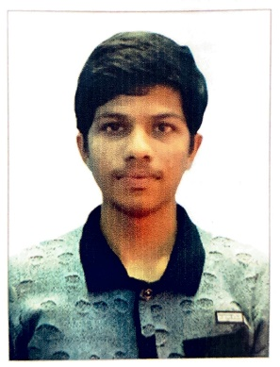
Anomalies detection in crop health and creating a custom flight path.
CB.EN.U4AEE21034
Erukala Sashank
CB.EN.U4AEE21046
Vishwa K
CB.EN.U4AEE21057
Magesvar
Review - 3
Git hub URL: https://github.com/123sashank321/Anamolies_Detection_in_Crops
Sites.google : https://sites.google.com/view/anamolies-detection-in-crops/home
Professor : Dr. T Senthil Kumar(CSE)
Collaborator : Mr. Akash (Sky –X)
Professor : S Thangeswari

Slide 2
Contents
Overall Architecture Diagram
Existing Product features
Module Diagram
Explanation of Modules
Technology Stack
UI wireframe designs --- For each module
Working of the product

Slide 3
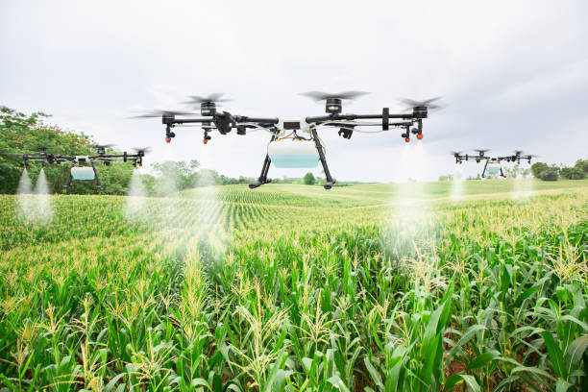
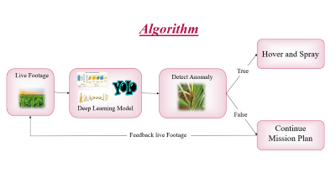
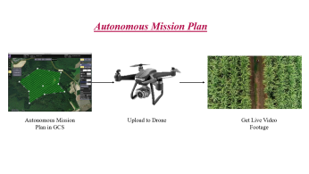
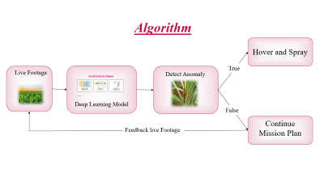
Overall Architecture Diagram
Autonomous Mission Plan
Output
AI and Algorithm

Slide 4
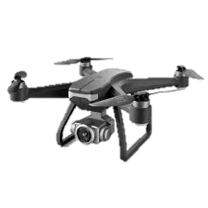
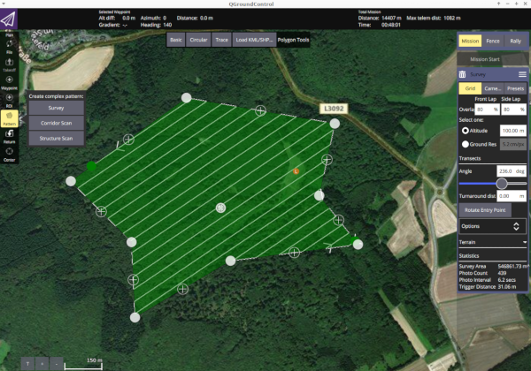
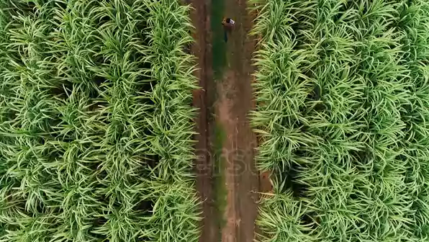
Autonomous Mission Plan
Autonomous Mission Plan in GCS
Upload to Drone
Get Live Video Footage

Slide 5
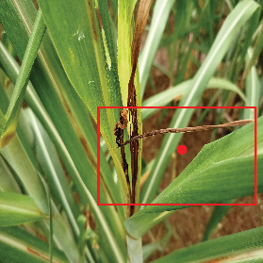

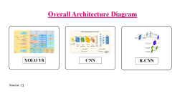
Algorithm
Hover and Spray
True
Live Footage
Detect Anomaly
Deep Learning Model
False
Continue Mission Plan
Feedback live Footage

Slide 6
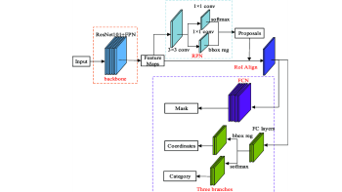
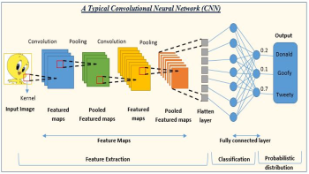
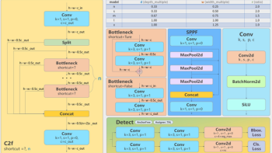
Overall Architecture Diagram
YOLO V8
CNN
R-CNN
Source : []

Slide 7
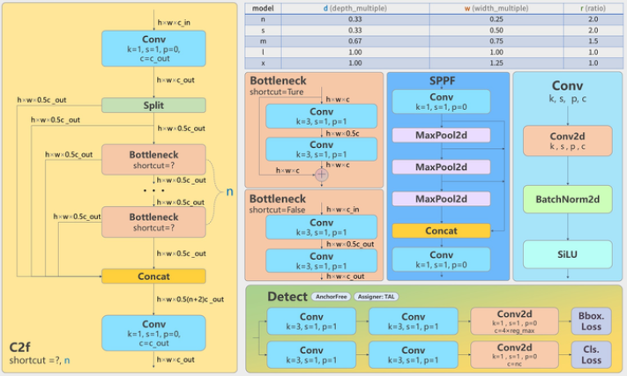
Overall Architecture Diagram

Slide 8
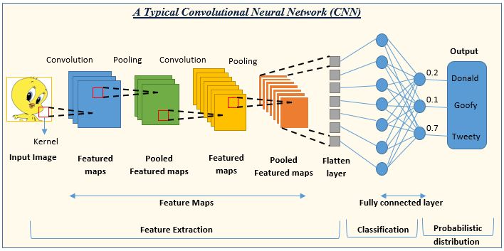

Slide 9
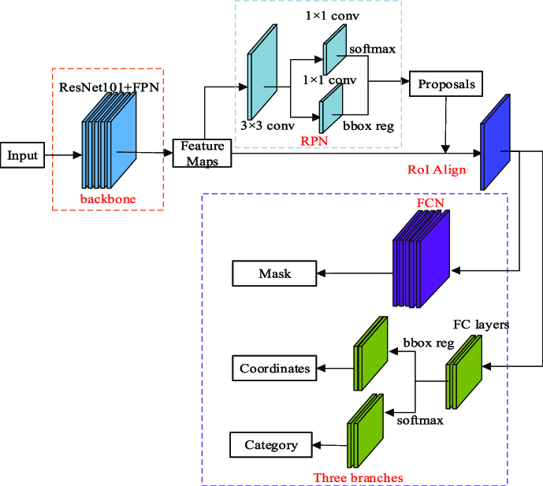

Slide 10
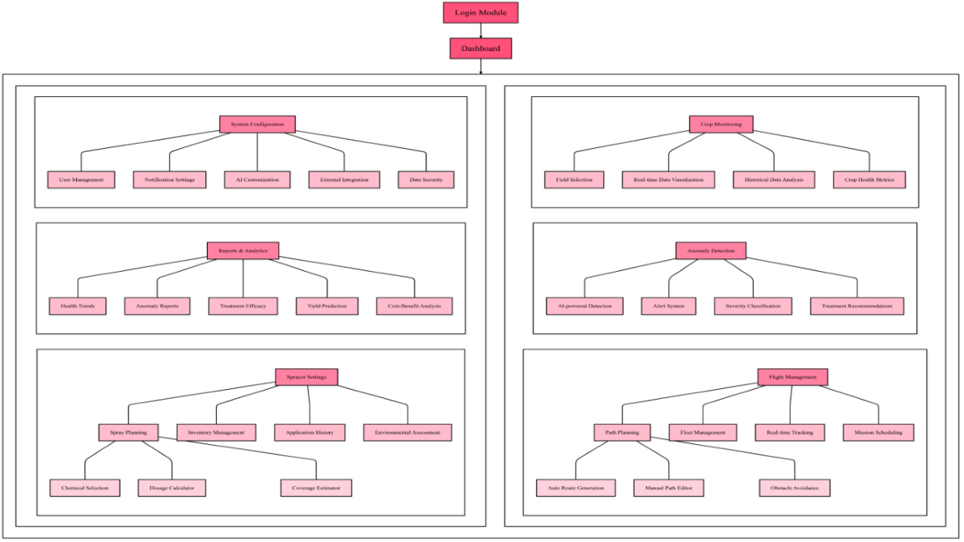

Module Diagram

Slide 11


Slide 12

Explanation of Modules
1. Login Module
Technology: Firebase Authentication
Functionality: Secure user authentication and management.
2. Dashboard
Technology: React.js
Functionality: User-friendly interface for system navigation and monitoring.

Slide 13
Explanation of Modules
3. Crop Monitoring
Library: OpenCV
Functionality: Image processing for real-time monitoring of crop health.

Slide 14
Explanation of Modules
4. Anomaly Detection (with Deep Learning)
Library: TensorFlow
Functionality: AI-driven detection of crop anomalies.

Slide 15
Explanation of Modules
5. Flight Management
Technology: QGroundControl
Functionality: Comprehensive management of flight paths and missions.

Slide 16
Explanation of Modules
6. System Configuration
Technology: Node.js with Express.js
Functionality: API management for system settings and configurations.

Slide 17
Explanation of Modules
7. Reports & Analytics
Library: Chart.js
Functionality: Visualization of crop health trends and treatment efficacy.

Slide 18
Explanation of Modules
8. Sprayer Settings
Technology: React.js
Functionality: UI to configure and manage sprayer settings.

Slide 19










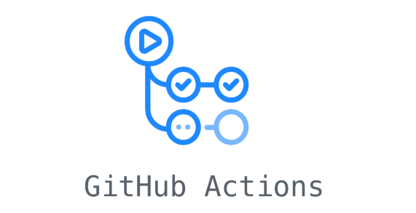

Technology Stack
Data
Development
Deployment

Slide 20
UI Wireframe designs
Module | Wireframe Design | Student
3.Crop Monitoring 4.Anomaly Detection | Crop Monitor Anomaly | E. Sashank (CB.EN.U4AEE21034)
5. Flight Management 6. System Configuration | Path Planning | K Vishwa (CB.EN.U4AEE21046)
7. Report & Analytics 8. Sprayer Settings | Sprayer | Magesvar (CB.EN.U4AEE21057)

Slide 21
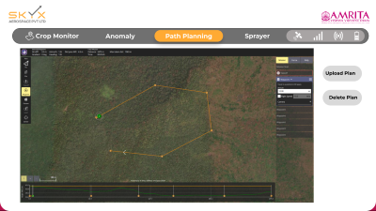
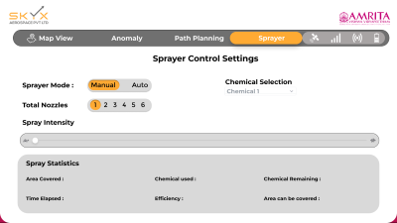
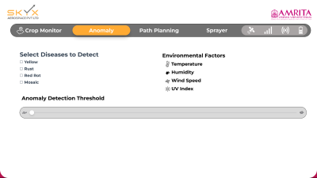
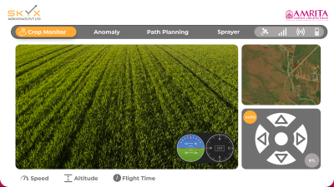
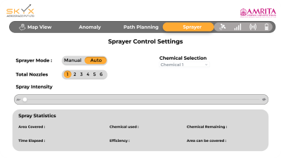
UI Wireframe designs

Slide 22
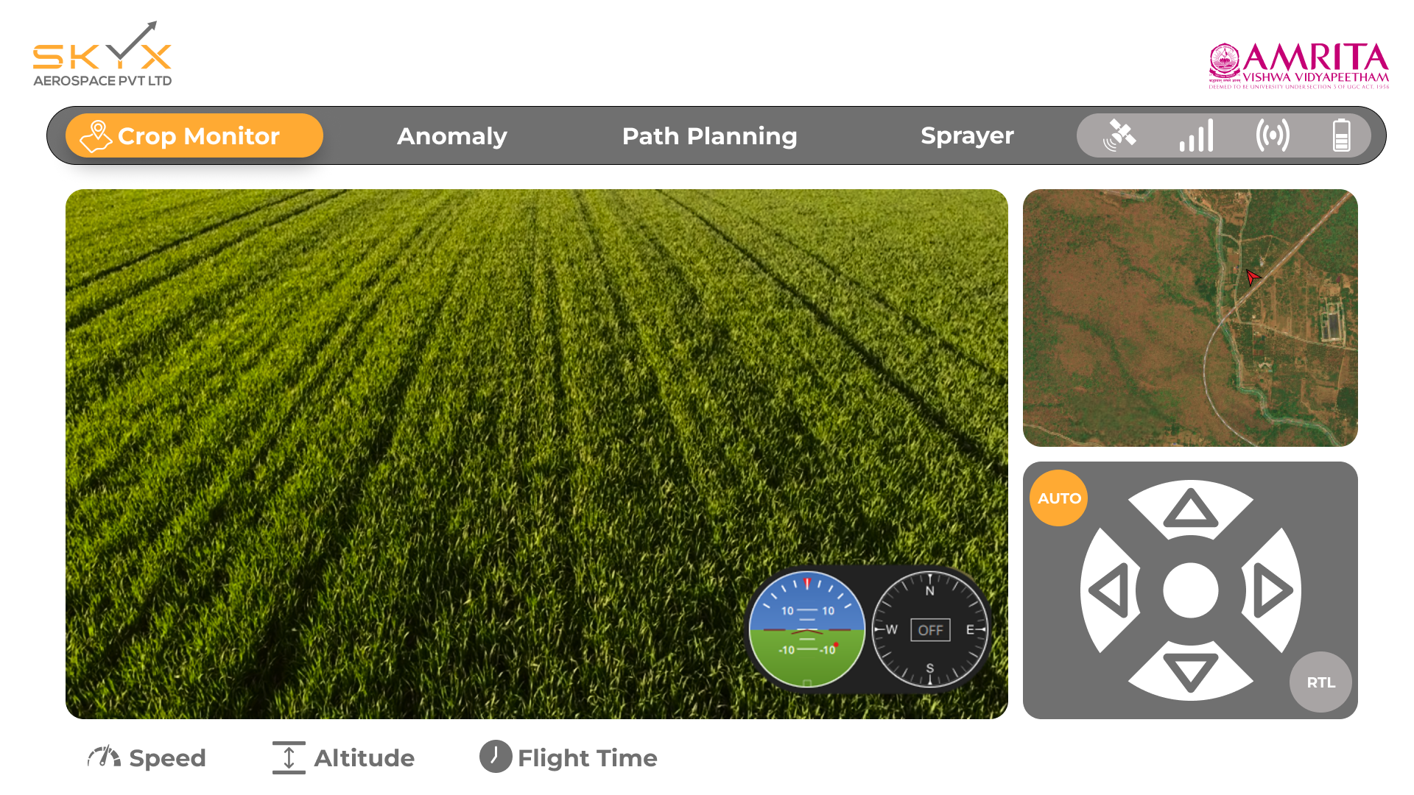

Slide 23
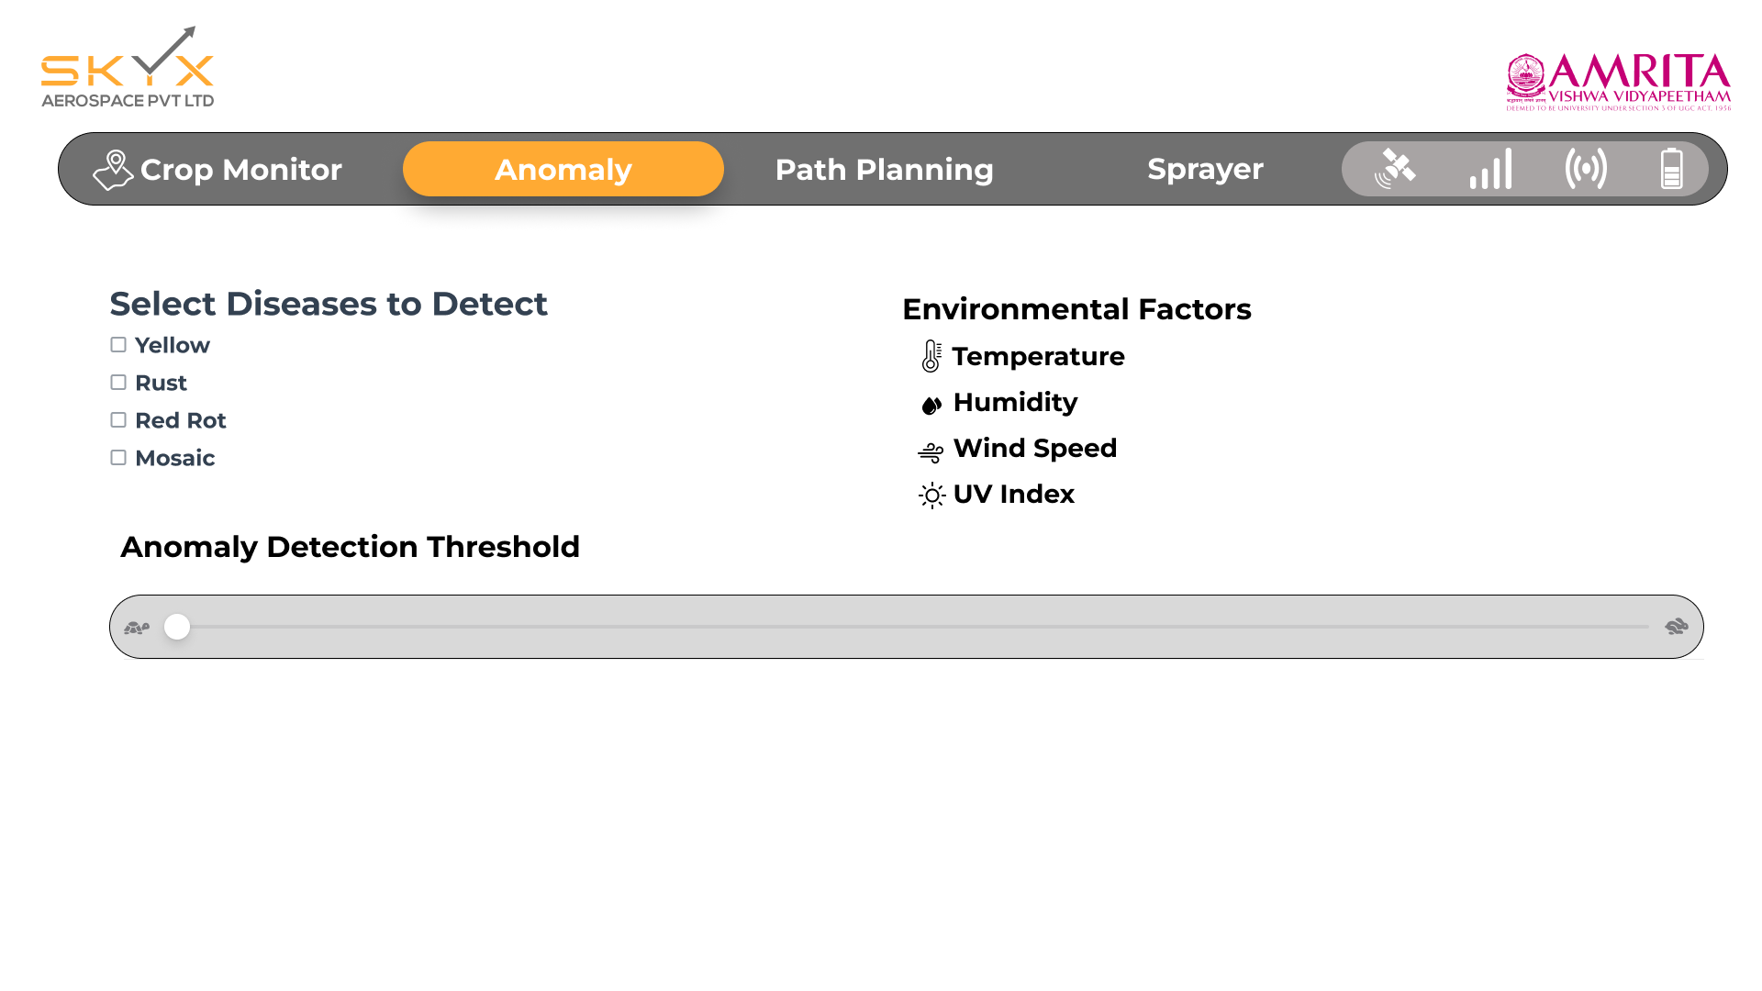

Slide 24
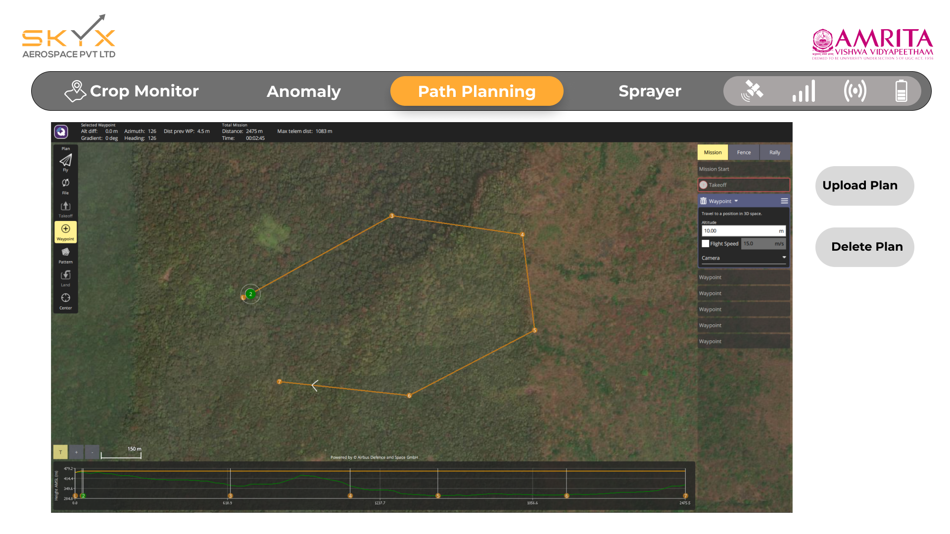

Slide 25
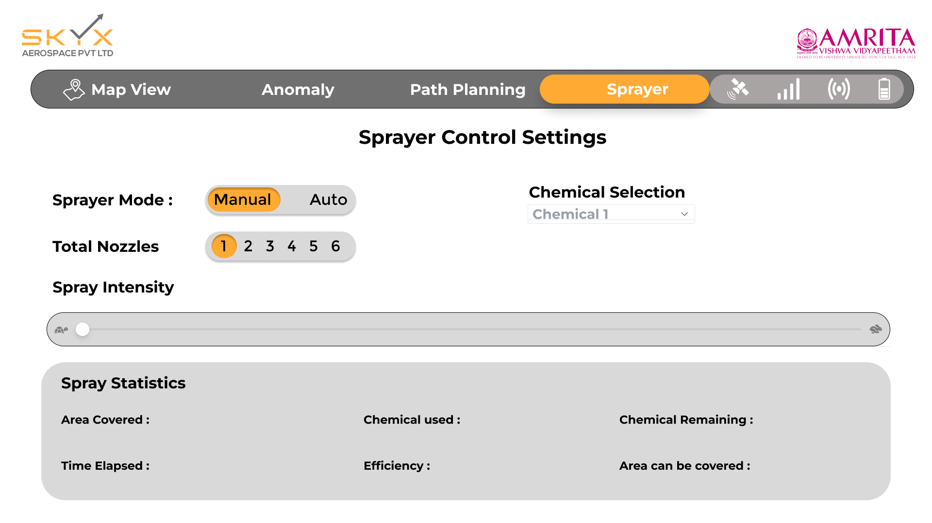

Slide 26


Slide 27
Working of the Product
User Login and Access
2. System Configuration & Personalization
3. Crop Monitoring and Data Input
4. Anomaly Detection and AI Insights
5. Automated Flight Path Generation for Drones
6. Pesticide Treatment Optimization
7. Post-Treatment Reports and Analytics
8. Continuous Learning and Adaptation

Slide 28
Thank You

